Slide 1

Wireless Networking
Ambuj Varshney
Assistant Professor, National University of Singapore
Wireless, Embedded Intelligence, Sensing, and Emerging Technologies Group
ambujv@nus.edu.sg

Slide 2
Administration and Course Logistics

Slide 3
Course homepage and webcast of lectures
Course homepage and other information can be found on following links:
Canvas (updated less frequently)
(Frequent updates) Link: https://weiserlab.github.io/ambuj/cs4222
We also have a slack page! If you are not added, please send me email
Video. Important parts of lecture 1,2 uploaded to YouTube
Tutorials: Would shortly release the solutions to Tutorial 1
Request from students: Release early -> Next tutorial released on Friday
Notes:
++ We may all have heard of the term Internet of Things. So how are these wireless embedded systems related to the Internet of Things: Today, IoT includes a broad class of devices, including powerful platforms such as smartphones. However, it also includes more resource-constrained devices and what we call Wireless Embedded Systems, and in fact, I consider it to be one of the essential parts of the IoT ecosystem.
++ These are platforms equipped with a radio transceiver, sensor, microcontroller, and some form of energy storage. These platforms also often form a network, and sensor network as it is called has been an active area of research for the past two decades.
++ The research community has also developed wireless embedded platforms which we may know about, and these include: CMUCAM, which is an image sensor platform developed at Carnegie Mellon University, or Permamote is long life sensor platform from the lab I am associated with at UC Berkeley or Lorea which is a long-range backscatter platform that I had developed as part of my doctoral dissertation at Uppsala University. All of these are an example of Wireless Embedded Systems.

Slide 4
Assignment 1
Link: https://weiserlab.github.io/ambuj/cs4222_assignment1
Deadline: 10th of February 2023
Covers: 3% of overall grade
Task: Program SensorTag, display your name, blink onboard LED
Show to teaching assistant/instructor during next week’s tutorial
Issue: Some students are having issue on Mac OS X!
Notes:
++ We may all have heard of the term Internet of Things. So how are these wireless embedded systems related to the Internet of Things: Today, IoT includes a broad class of devices, including powerful platforms such as smartphones. However, it also includes more resource-constrained devices and what we call Wireless Embedded Systems, and in fact, I consider it to be one of the essential parts of the IoT ecosystem.
++ These are platforms equipped with a radio transceiver, sensor, microcontroller, and some form of energy storage. These platforms also often form a network, and sensor network as it is called has been an active area of research for the past two decades.
++ The research community has also developed wireless embedded platforms which we may know about, and these include: CMUCAM, which is an image sensor platform developed at Carnegie Mellon University, or Permamote is long life sensor platform from the lab I am associated with at UC Berkeley or Lorea which is a long-range backscatter platform that I had developed as part of my doctoral dissertation at Uppsala University. All of these are an example of Wireless Embedded Systems.

Slide 5
Lecture 3: Review, Sensors, Actuators, and Energy Management

Slide 6
Learning Objective for Today’s Lecture
Review: last few lecture’s topics
Unit: dB and dBm
Overview of sensing modalities: active vs passive
Active sensing: LIDAR and Ultrasound
Passive sensing
Platforms
Calculating Battery-life

Slide 7
Review (last lectures)

Slide 8
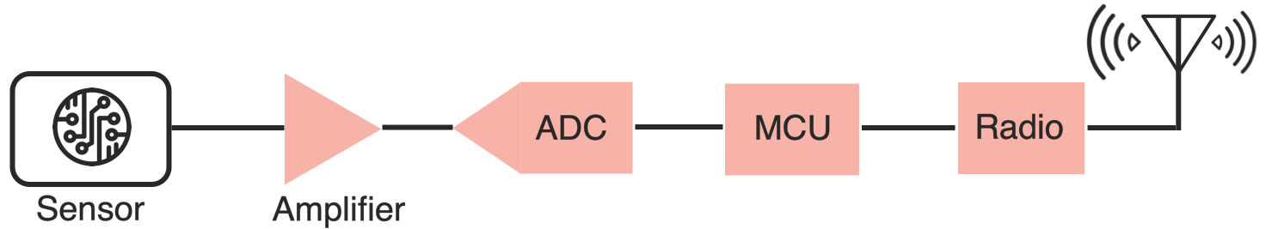
Sensing, Computing and Wireless Communication
IoT device performs (primarily) three tasks: Sensing, Computing and Wireless Communication

Slide 9
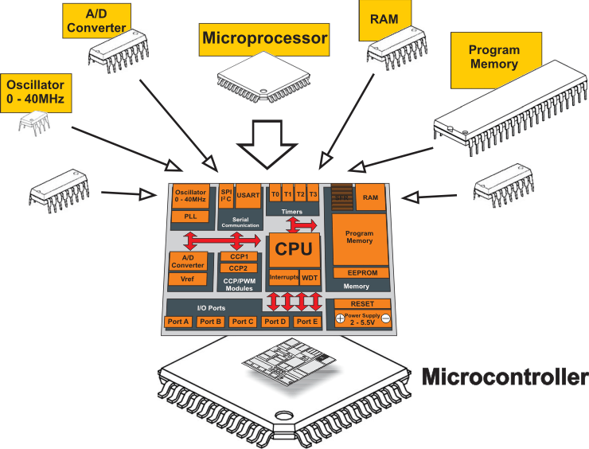
Heart of IoT devices: What is a microcontroller?
A microcontroller (MCU) is a small computer on a single integrated circuit consisting of a relatively simple central processing unit (CPU) combined with peripheral devices such as memories, I/O devices

Slide 10
Operating system for the IoT platforms
Cannot run classic Windows. Even Linux might be too big for many of IoT devices
Several open source operating systems; Ex - TinyOS, RIOT, Zephyr, and Contiki OS
We will use Contiki OS: Individual projects and some group projects
Memory-efficient: 2 kB RAM, 40 kB ROM typically, provides IP support (its uIPv6 stack is IPv6 Ready), supports multi-threading, Protothreads
Runs on many embedded platforms (AVR, MSP430, MSB430, ESB, Apple II, C64, Atari Jaguar, Tandy CoCo, Casio PocketViewer, Sharp Wizard, PC 6001, and many others)
Written in C, under BSD License
Good introduction: course webpage has several articles and interviews

Slide 11



Contiki OS: History and real-world usage
Started in Sweden! Started by – Adam Dunkels at SICS, now Thingsquare
Last year: Awarded 2022 Sensys Test-of-Time Award for Protothreads (2004)
Many developers including in open-source community. Got me interested in this area
Many companies and universities are developing (or has contributed) Contiki OS:
SAP, Cisco, Atmel, NewAE and others
SICS, TU Munich and others

Slide 12
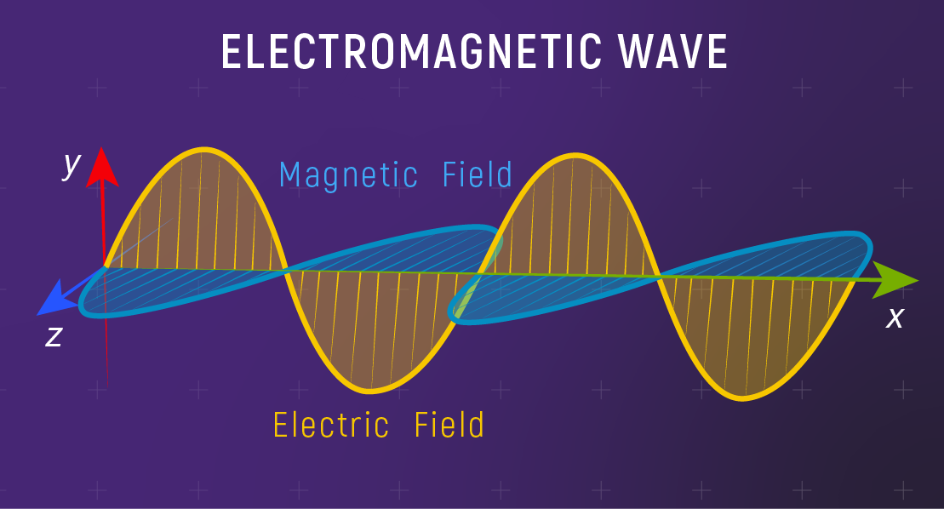
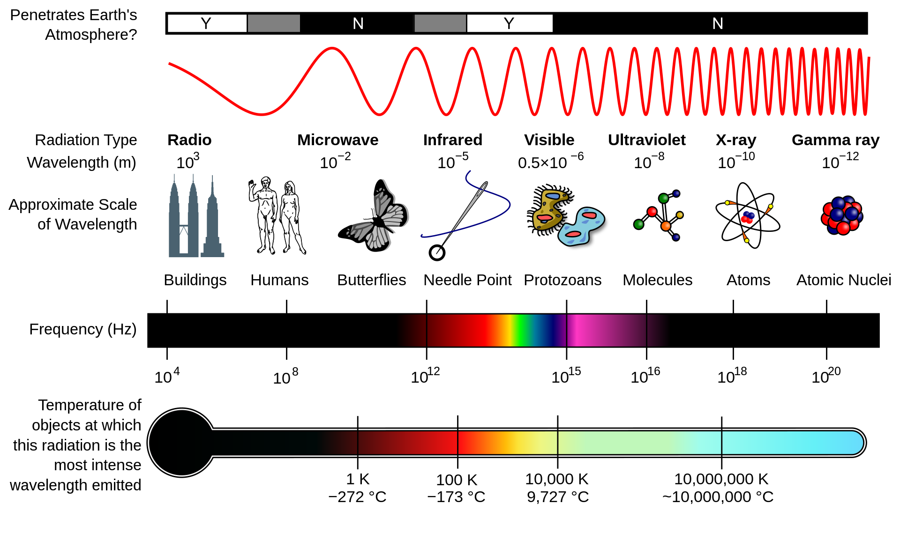
Electromagnetic waves and spectrum
Electromagnetic waves are synchronized oscillations of electric and magnetic field. There is a periodic change of electric and magnetic field
How often this periodic change occurs dictates the property of EM waves

Slide 13
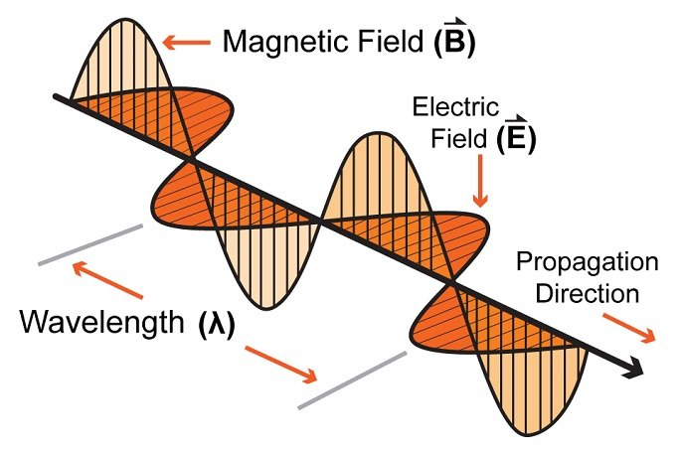
Characterization of radio waves
Signal strength
The amount of energy transmitted/received
Signal frequency and bandwidth
Which “channel” the signal is sent on
Signal modulation
How data is encoded in the signal

Slide 14
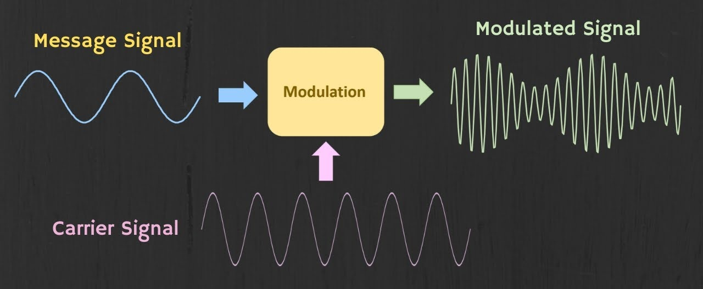
How are radio waves modulated with information
Encoding information “baseband" in an analog “carrier” signal
Baseband signal often much lower frequency than carrier
Carrier signal defines the frequency/part of electromagnetic spectrum

Slide 15
Learning Objective for Today’s Lecture
Review: last few lecture’s topics
Unit: dB and dBm
Overview of sensing modalities: active vs passive
Active sensing: LIDAR and Ultrasound
Passive sensing
Platforms
Calculating Battery-life

Slide 16
Estimating received signal strength and communication range: Friis propagation equation
For line-of-sight path
f_{c} is the center frequency in Hz
c is speed of light
d is the distance between transmitter and receiver
Alpha is the path loss component
G is antenna gain

Slide 17
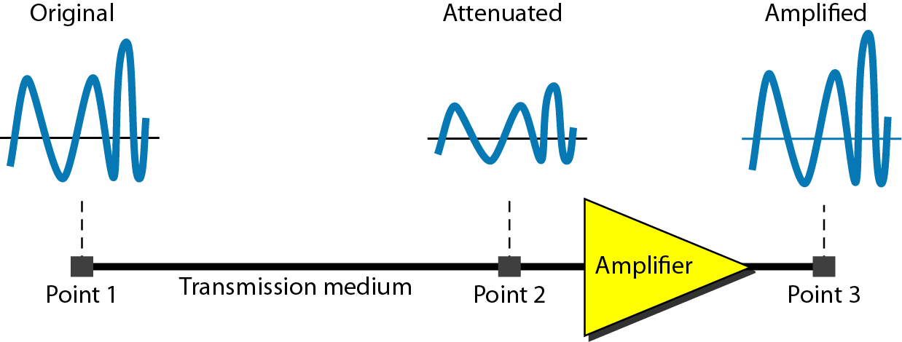
Attenuation and Gain: Decibel (dB) unit
Attenuation: Means loss of energy
When signal traverses through a medium, it loses energy.
Gain: Means increase in energy
Often devices such as amplifiers are employed to improve the signal strength
Commonly, we use decibel to calculate gain or loss/attenuation of signal
dB = 10log₁₀P₂/P₁
P₁ - input signal, P₂ - output signal

Slide 18
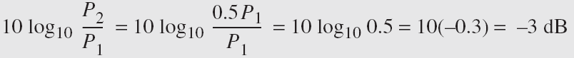
Operations in decibel (dB) examples
Suppose a signal travels through a transmission medium and its power decreases to one-half of its original value, meaning that P2 is equal to (1/2)P1. In this scenario, the attenuation, or loss of power, can be determined using the following formula:
Thus, loss of 3 dB, is equivalent to losing half of the signal power

Slide 19
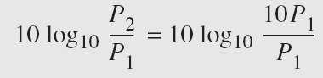
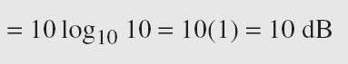
Operations in decibel (dB) examples
A signal passes through an amplifier, resulting in a tenfold increase in power, expressed as P2 = 10P1. The amplification, also known as the power gain, can be calculated as:
One reason engineers use decibels to measure changes in signal strength is that decibel values can be easily added or subtracted
L1 = 3b, L2 = 7 db, Combined loss: 10 dB

Slide 20
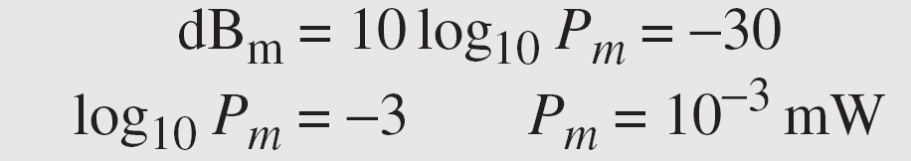
Unit of power of a signal: dBm (decibel milliwatt)
Decibel (dBm) is a measure of signal power, calculated as 10 log10 (Pm) where Pm is power in milliwatts
Example: Calculate the power of a signal with dB_{m} = −30
Caution: We can add/subtract dB and dB term together, but we cannot perform these operations on dB and dBm term and vice versa

Slide 21
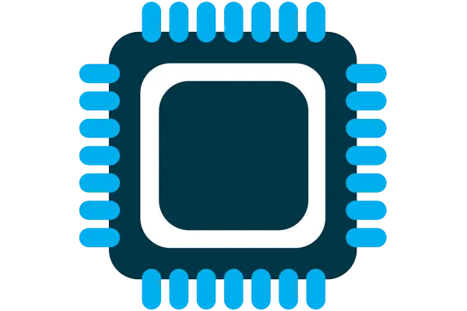



Four major components of IoT device
Computation and Storage
Sensing and Actuation
Power
Wireless Connectivity

Slide 22
Four major components of IoT device
Computation and Storage
Sensing and Actuation
Power
Wireless Connectivity

Slide 23
Learning Objective for Today’s Lecture
Review: last few lecture’s topics
Unit: dB and dBm
Overview of sensing modalities: active vs passive
Active sensing: LIDAR and Ultrasound
Passive sensing
Platforms
Calculating Battery-life

Slide 24
Sensors and Actuators
Notes:
Sensors and actuators play a crucial role in the functioning of IoT devices. They allow these devices to perceive and interact with the physical world. Sensors serve as the device's eyes, collecting data from the environment and sending it to the processor. A device's actuators, on the other hand, act as its "hands," allowing it to manipulate and influence the physical world. Sensors and actuators work together to make IoT devices intelligent, allowing them to respond to changing conditions and interact with the world in meaningful ways.

Slide 25
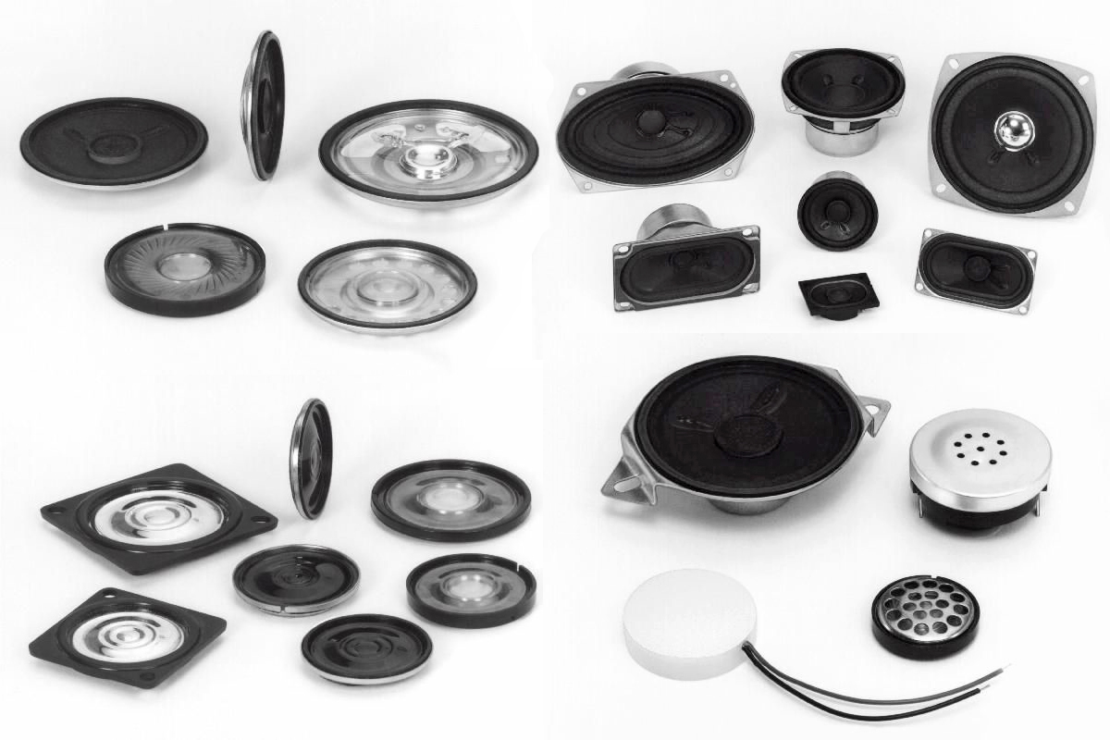

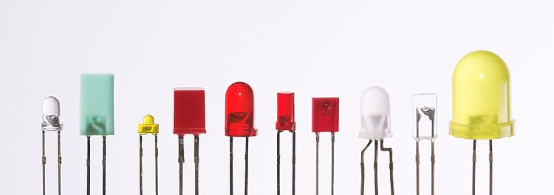
Definitions: What are actuator?
Actuator is a device that modifies a physical quantity
Light/LED
Motor
Speaker
…….
Notes:
Let's begin by discussing Actuators. They are a crucial component in IoT devices, allowing them to modify physical quantities and interact with the environment.
Actuators come in various types, each with its unique function. Some of the most common types include:
Light/LEDs - These emit electromagnetic radiation in the light spectrum, providing us with a visual representation of the world.
Motors - These allow IoT devices to move and physically interact with their surroundings.
Speakers - These generate acoustic signals by emitting sound waves, allowing the device to communicate in the auditory domain.
It is important to note that the choice of the actuator depends on the specific task that the IoT device is designed to perform and the environment in which it will operate. As a result, each type of actuator has its advantages and disadvantages, and selecting the appropriate actuator will play a key role in determining the overall performance and effectiveness of the device.
Typically, actuation is an energy-expensive task.

Slide 26
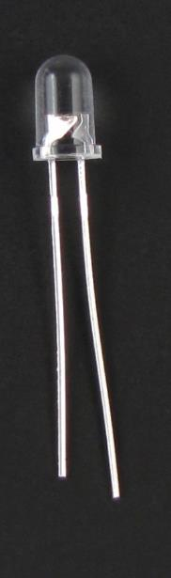
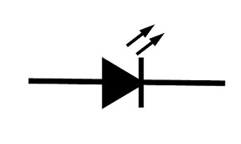
Light emitting diodes (LEDs)
Directional component: only allows current to flow one way
Shorter side is the negative one
i.e. where current flows to
Larger metal component
inside of case or case flat spot is cathode or
negative (-) lead
Shorter wire is cathode or
negative (-) lead
Negative ( - ) lead
Schematic Symbol
Notes:
Light Emitting Diodes (LEDs) are vital actuators for embedded and Internet of Things (IoT) devices. They provide a visual indication of the device's state and can also be used for debugging purposes. LEDs are directional components that allow current to flow in one direction only.
Typically, the cathode, where the current flows, is the shorter side of the LED. LEDs are an effective way to indicate the status of a device and provide feedback during the development and testing phase.
They are also commonly used in consumer electronics and lighting applications.

Slide 27
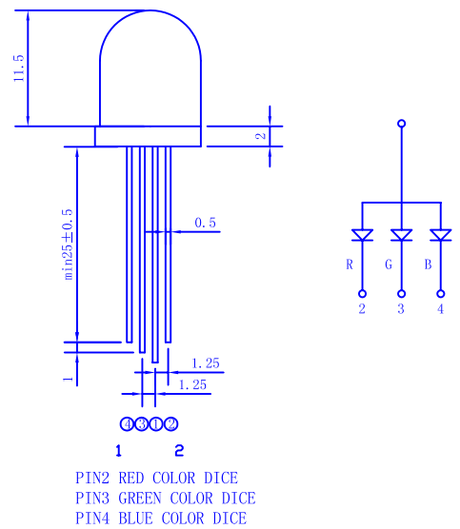
RGB LEDs
Three different colors of LED in a single large diffuser
Short leads are negative ends
One for each color
Long lead is common power
Common anode
Combinations of LEDs give other colors
Cyan, Yellow, Violet, White
https://cdn-shop.adafruit.com/datasheets/FLR-100WAS-RGB.pdf
Notes:
A unique variant of LEDs is the RGB (Red, Green, Blue) LED, which allows for the emission of three different colors. The short leads are the negative end, and each color has its own separate wire. By combining signals on multiple wires, a range of colors can be produced. RGB LEDs provide a versatile and efficient solution for adding color to embedded and IoT devices, as well as for lighting applications. By controlling the intensity of each color, a wide range of hues and shades can be generated, making RGB LEDs ideal for applications where dynamic color changes are desired.

Slide 28
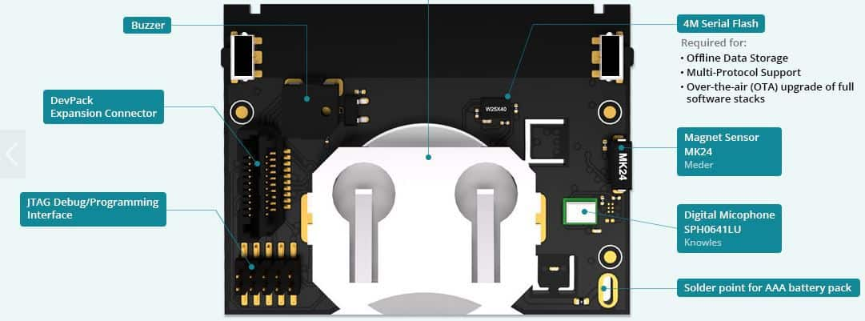
Actuators on Sensor Tags?

Slide 29
Definitions: What are sensors?
Sensor is a device that measures a physical phenomenon
Temperature sensor
Humidity sensor
Acoustic sensor
Image sensor
…….
Sensors have become numerous, and are very low-power, and capable
Notes:
Sensors enable the measurement of physical phenomena and play a crucial role in functioning Internet of Things (IoT) devices. Sensors come in various shapes and sizes and allow IoT devices to perceive the world around them.
Over the past few decades, sensors have undergone significant advancements, becoming low-power, capable, and versatile. As a result, sensors are often the lowest power-consuming component in a typical IoT device.
This has enabled the widespread adoption of sensors in various applications, from environmental monitoring to industrial automation.

Slide 30

Actuation is energy expensive (with respect to sensing)

Slide 31
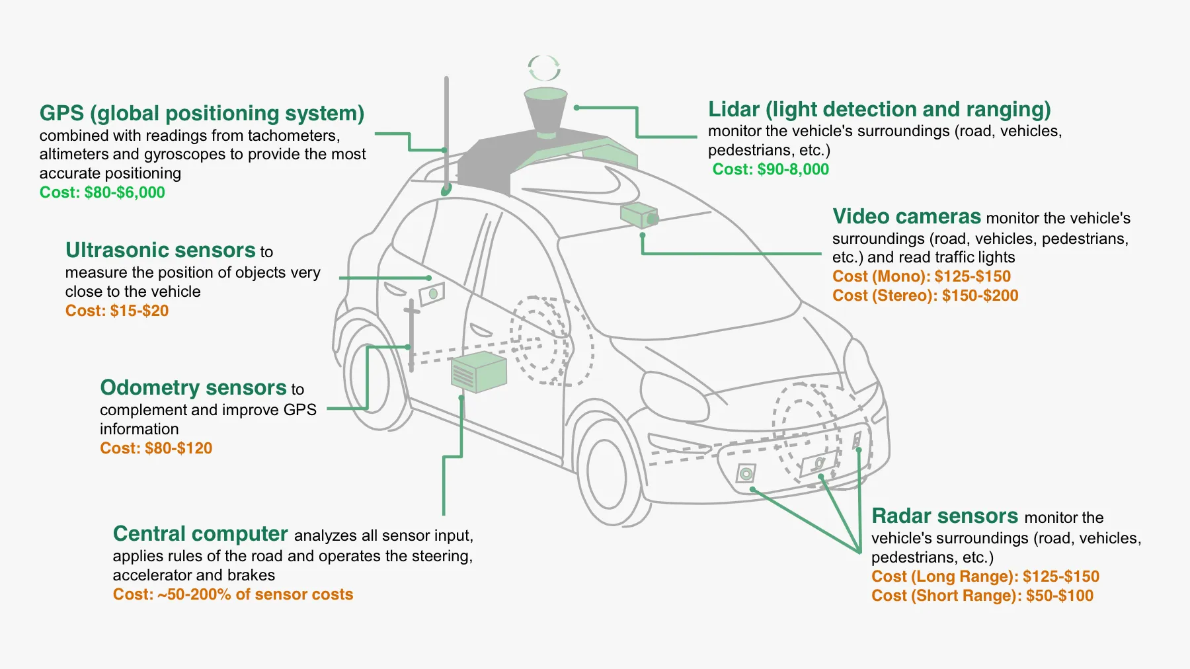
Modern cars are all software and sensors

Slide 32
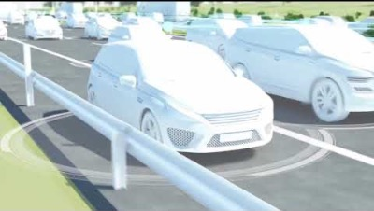
Modern cars are all software and sensors

Slide 33
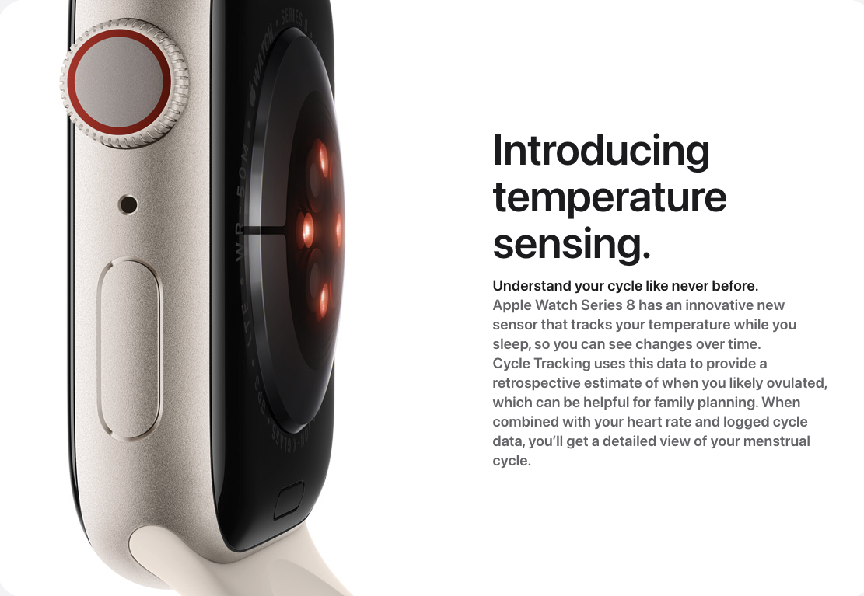
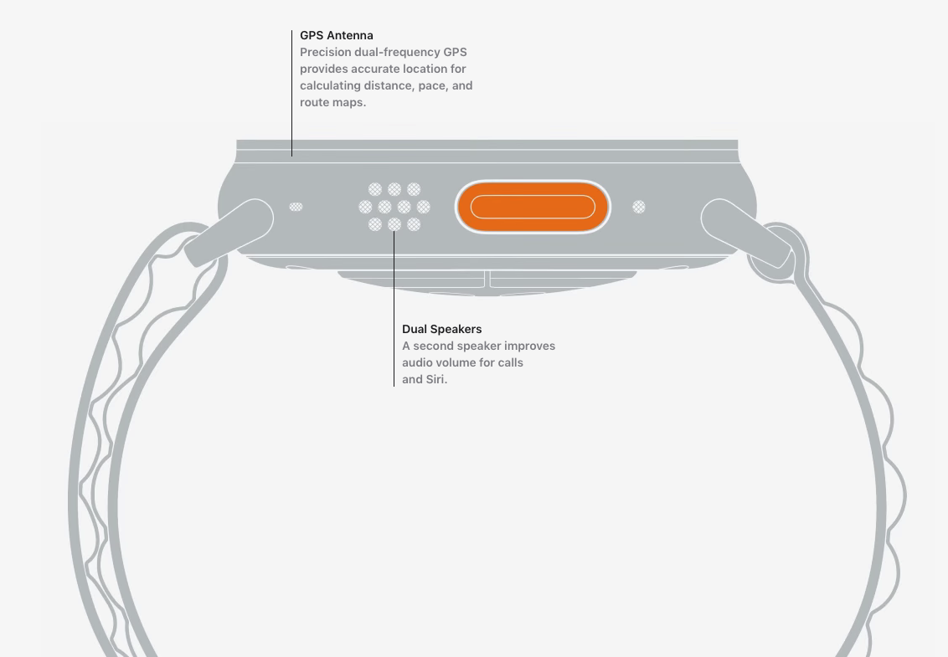
Sensors and actuators are an integral part of most consumer electronic devices
Essential part of almost all consumer electronic devices
They are an Interface of electronic devices with the physical world
Courtesy: Apple

Slide 34
Learning Objective for Today’s Lecture
Review: last few lecture’s topics
Unit: dB and dBm
Overview of sensing modalities: active vs passive
Active sensing: LIDAR and Ultrasound
Passive sensing
Platforms
Calculating Battery-life

Slide 35
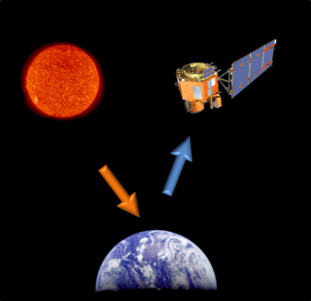
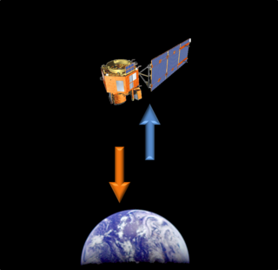
Different forms of sensing: Active vs Passive
Passive Sensing
Active Sensing
Notes:
There are two main types of sensors and sensing methods: active and passive. Active sensors actively emit a signal, which is then reflected off the environment and captured back by the sensor to gather information about the surroundings. In contrast, passive sensors do not emit any

Slide 36
Different forms of sensing: Active vs Passive
We usually focus on passive sensing
Cheaper and lower energy costs!
No emissions from the sensor. Passively sense environment
Active sensing:
Flash photography
Ultrasonic distance sensing
Lidar and Radar
Notes:
Typically, for Internet of Things (IoT) devices, passive sensing is the preferred method due to its lower cost (as passive sensors are cheaper) and reduced energy consumption. With passive sensing, the sensors do not emit any signals and instead gather information from the environment without actively participating, resulting in lower energy usage.
Typical example of active sensing system includes:
Flash photography
Flash lightens the room and then image is snapped by a camera
b) Ultrasonic sensing
c)Lidar
Lets look into ultrasonic and lidar

Slide 37

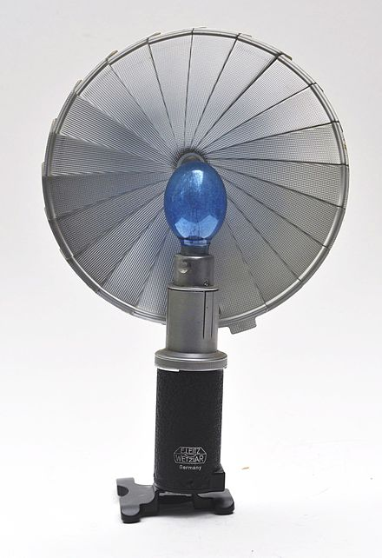
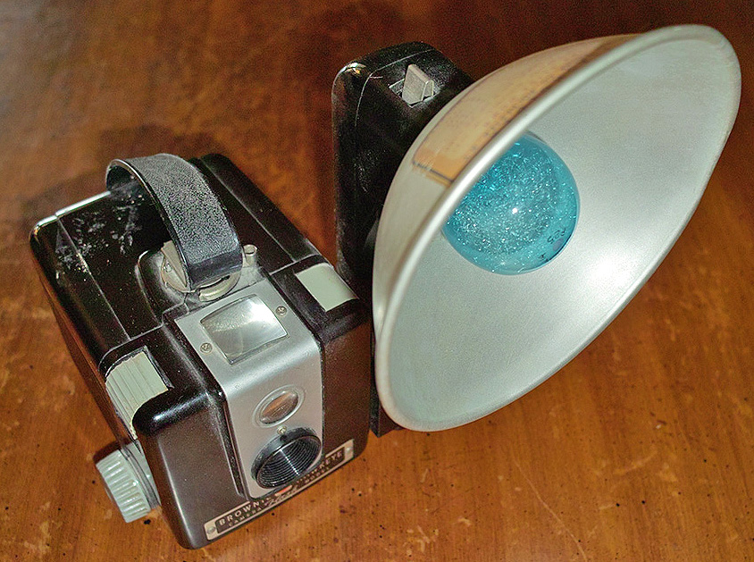
Active sensing: Flash photography

Slide 38
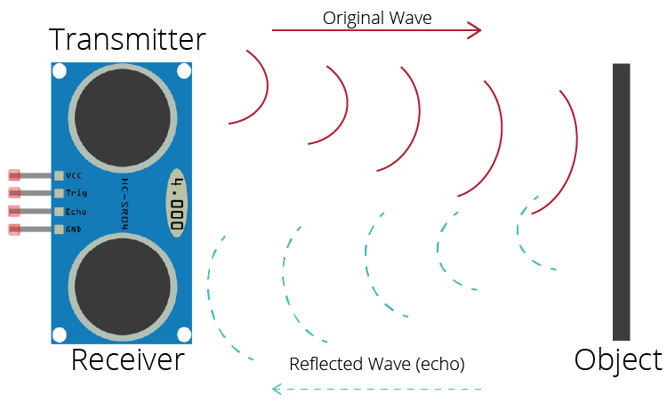
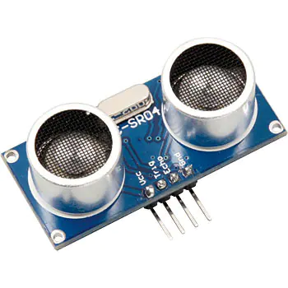
Active sensing: Ultrasound sensor
Emits high frequency sound waves from sensor which bounces from objects that are present in the environment
Estimates distance, proximity by measuring time taken for sounds waves to bounce back and propagate back to the ultrasound device
Power consuming, though can be used on IoT devices
Common application: Robotics, obstacle detection, water level sensing

Slide 39
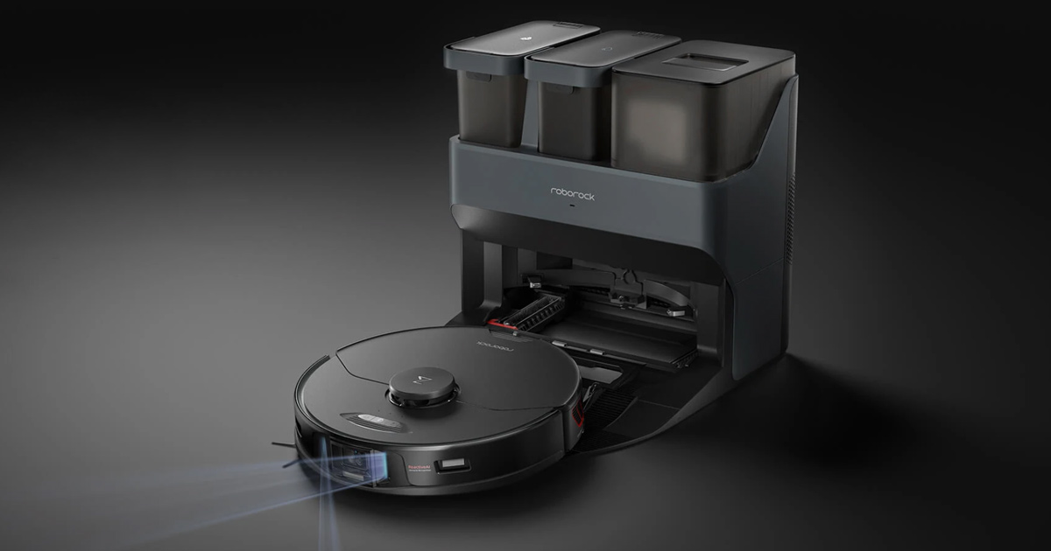
Active sensing: Your smart vaccum cleaner use?

Slide 40
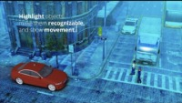
Active sensing: LIDAR

Slide 41
LIDAR (Light Detection and Ranging)
Remote sensing technology that uses laser for mapping environment
Form of active sensor, can be highly power consuming for IoT devices
At a high level the mode of operation of LiDAR:
Emits laser pulses, these bounce of objects in the environment
LIDAR device measures time taken for pulses to bounce of objects
Distance between LIDAR device and objects are calculated using speed of light and time taken for laser to travel after reflecting from objects
Commonly used: self-driving cars, robotics, for conducting surveys

Slide 42
Learning Objective for Today’s Lecture
Review: last few lecture’s topics
Unit: dB and dBm
Overview of sensing modalities: active vs passive
Active sensing: LIDAR and Ultrasound
Passive sensing
Platforms
Calculating Battery-life

Slide 43
Passive Sensing

Slide 44
Sensors transform physical phenomenon into an electric signal
Microcontrollers can only interact with analog (ADC) or digital signals
Generating an electrical signal proportional to a physical phenomenon allows the physical quantity to be sensed by a microcontroller
Most often we are generating an analog electrical signal
How do we generate an electrical signal?
Ohm’s Law: V = I * R (Voltage = Current * Resistance)
Vary one of these three (according to physical phenomenon) and an analog signal is created corresponding to the physical phenomenon

Slide 45
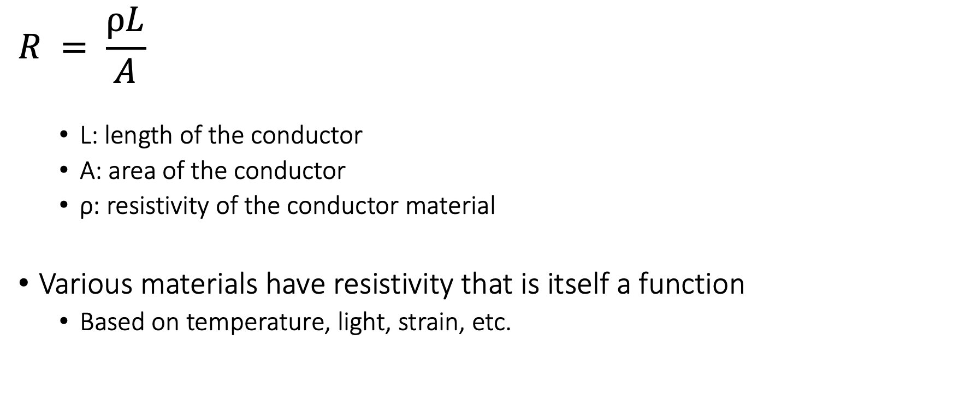
One of the major sensor type: Resistive
$$R = \frac{ρL}{A}$$
L: length of the conductor
A: area of the conductor
ρ: resistivity of the conductor material
Various materials have resistivity that is itself a function
Based on temperature, light, strain, etc.

Slide 46
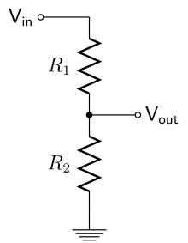
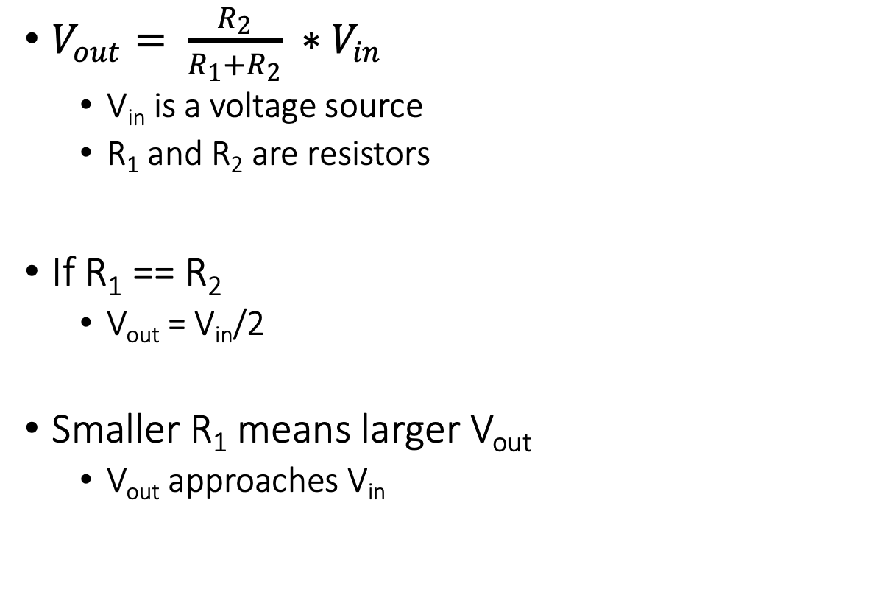
Electronics basics: Voltage dividers
$V_{out}= \frac{R_{2}}{R_{1}+R_{2}} ∗V_{in}$
V_{in} is a voltage source
R₁ and R₂ are resistors
If R₁ == R₂
V_{out} = V_{in}/2
Smaller R₁ means larger V_{out}
V_{out} approaches V_{in}

Slide 47
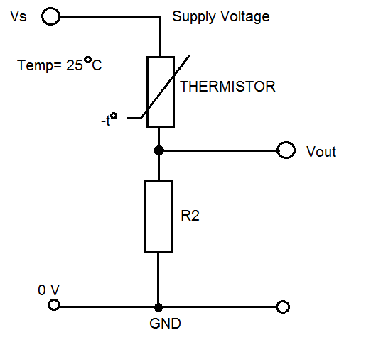
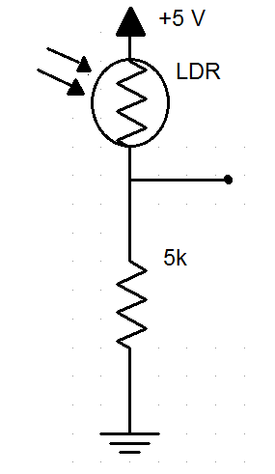
How do we measure a resistive sensor?
Place in series with another resistor
Between VCC and ground
Measure voltage between the two relative to ground
Forms a “voltage divider”

Slide 48
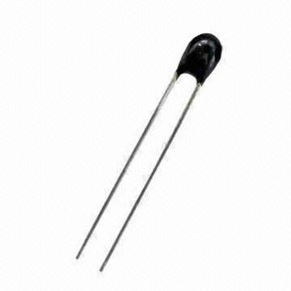
Example: Resistive temperature sensors
Thermistor varies resistance based on temperature
Set up as a voltage divider to measure
Advantages: cheap and easy to use
Disadvantages: non-linear transfer function

Slide 49
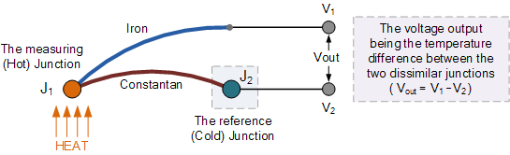
Other temperature sensor: Thermocouple
Thermocouple generates a voltage based on temperature
Can be used to harvest energy to run system

Slide 50
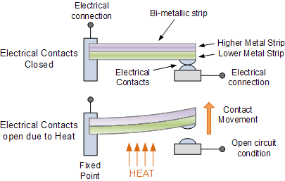
Other temperature sensor: Thermostat
Heat bends a strip of two different metals
Switches circuit on/off based on the temperature

Slide 51

Sensors in factories are becoming battery-free

Slide 52
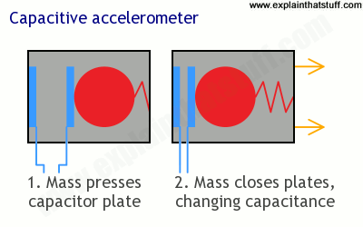
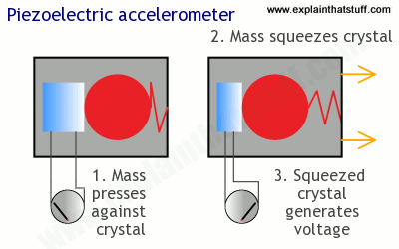
Motion sensing: acceleration
Goal: create a voltage that changes based on force

Slide 53
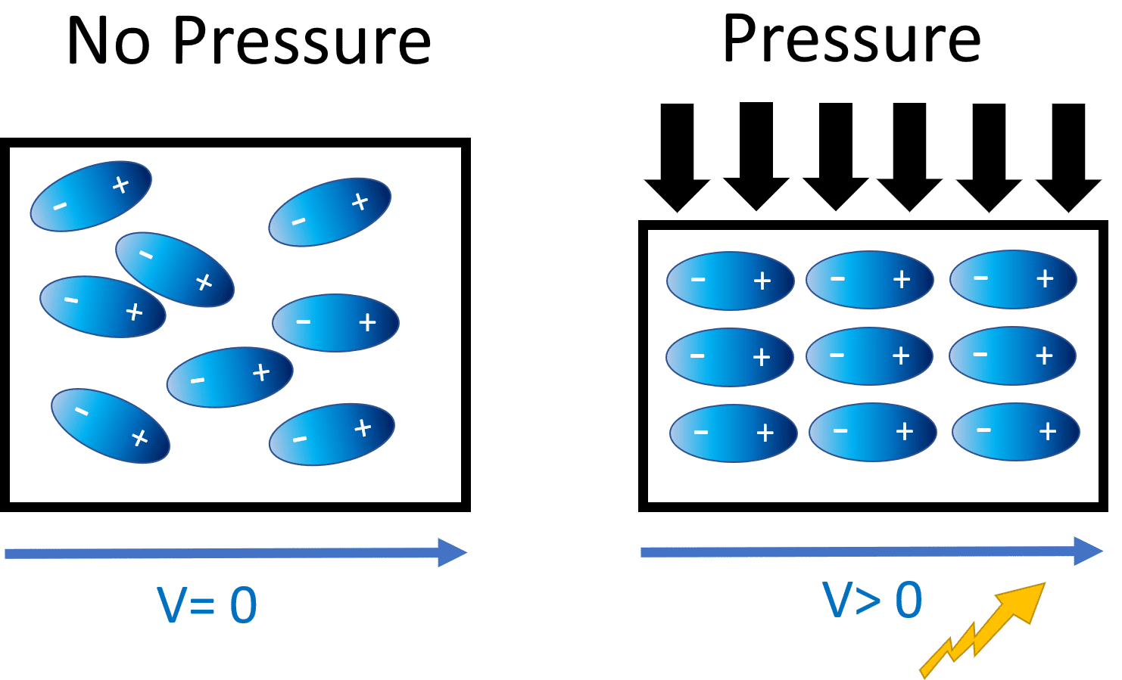
Generating voltage via piezoelectric effect
Compression of the material generates a voltage
Various sources of compression:
Air Pressure
Acceleration
Strain

Slide 54
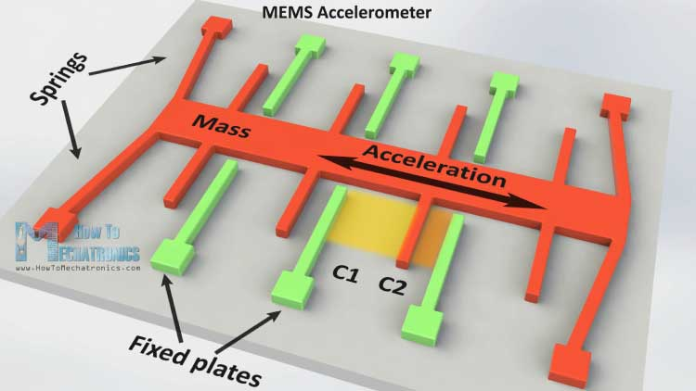
Motion sensing: Microelectromechanical Systems (MEMS)
Same concept, but within an IC and 1 to 100 micrometers in size

Slide 55
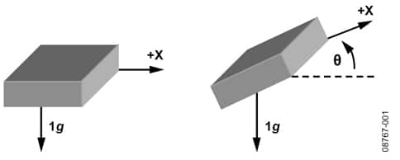
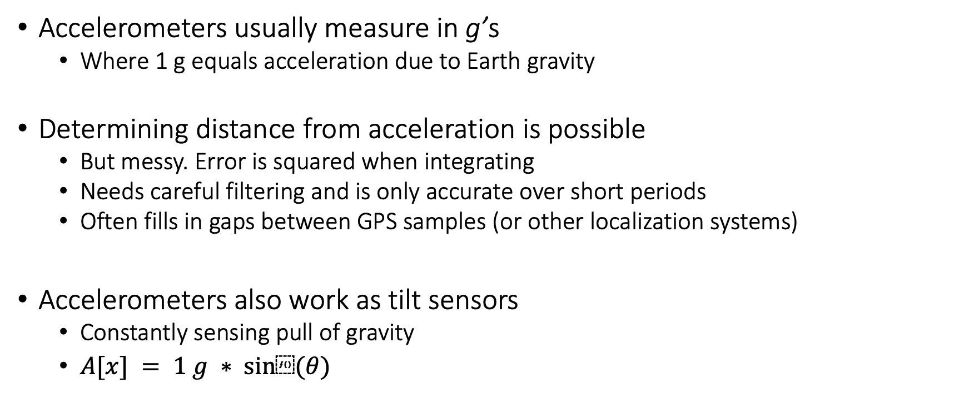
Motion sensing: accelerometers
Accelerometers usually measure in g’s
Where 1 g equals acceleration due to Earth gravity
Determining distance from acceleration is possible
But messy. Error is squared when integrating
Needs careful filtering and is only accurate over short periods
Often fills in gaps between GPS samples (or other localization systems)
Accelerometers also work as tilt sensors
Constantly sensing pull of gravity
$A[x] = 1 g ∗ sin⁡(θ)$

Slide 56
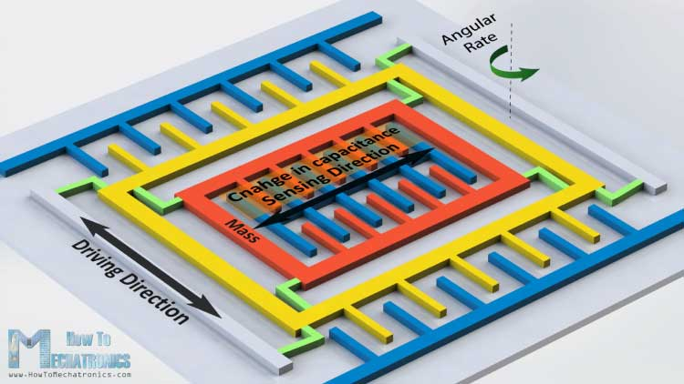
Motion sensing: Gyroscopes
Measures angular velocity
<10 rotations per second
Usually, we want angle instead of rotation speed
Integrate signal to determine current angle
Combine noise and DC bias with integration and you get a continuously accumulating error: drift

Slide 57

Motion sensors are an integral part of factories

Slide 58
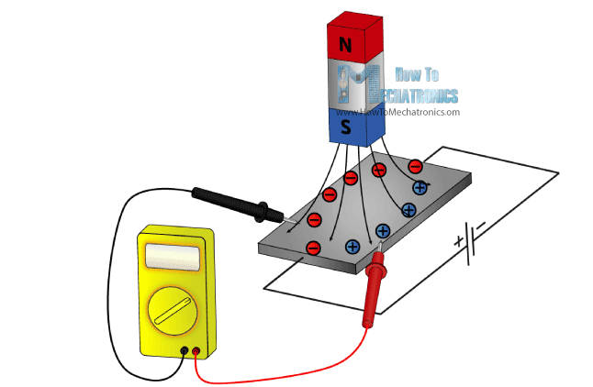
Other sensors: magnetic field (magnetometer)
Measures the magnetic field
Usually used in devices as a compass
Detect Earth’s magnetic field orientation
Satellites can use magnetometers for localization

Slide 59
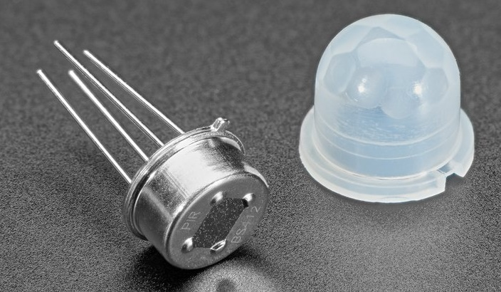
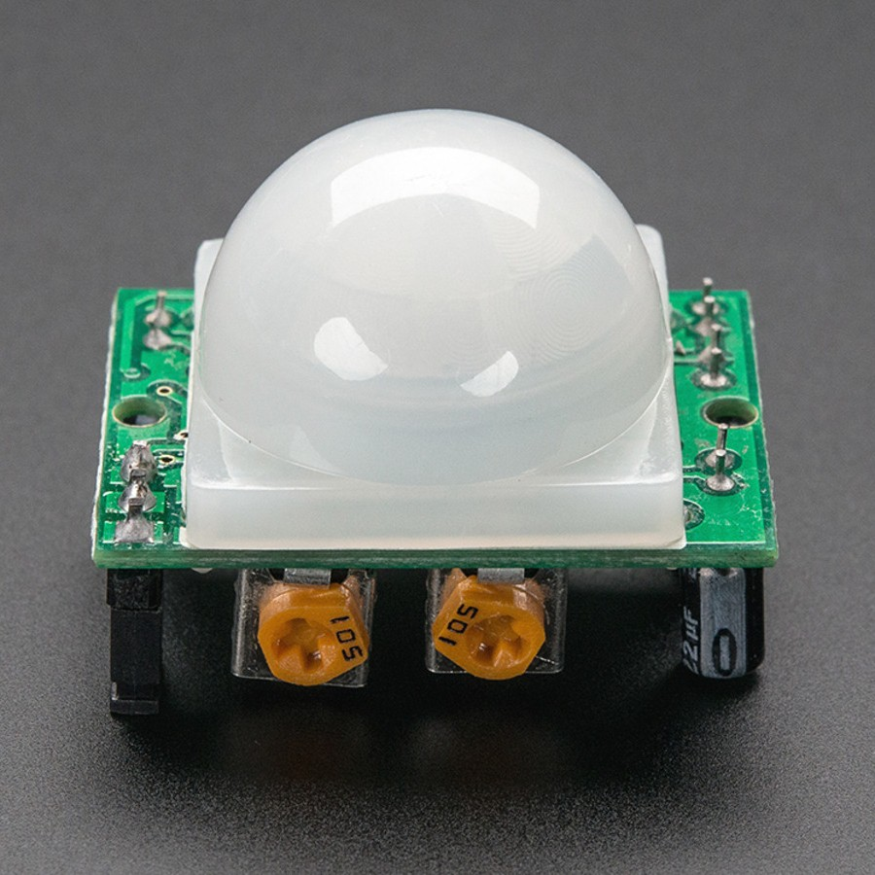
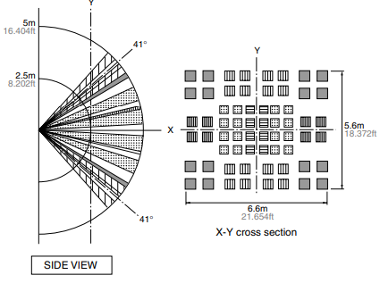
Passive Infrared (PIR) sensor
Detect movement in the environment
By detecting change in IR levels
Often come with plastic lens cover to improve field of view and range

Slide 60
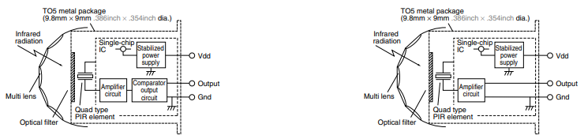

PIR sensors come in digital and analog forms
Digital includes a preconfigured comparator

Slide 61



We use PIR sensors in our day-to-day life

Slide 62



Even more types of sensors
Environment: Pressure, Humidity, Air Velocity, Air Quality
Distance: Ultrasonic, Lidar, or Radar
Biometric: Pulse Oximeter, Heart Rate
Agricultural: Soil moisture

Slide 63
Once you get a sensor signal, what do you do with this signal?
Need to understand the transfer function between voltage and the sensed quantity (physical phenomenon)
Examples for an accelerometer: senses acceleration
Digital components only understand digital signals
Convert the analog signal into digital

Slide 64
Analog signals are converted to digital signals
Microcontrollers only process digital signals
Analog signals are transformed into digital signals
Most microcontrollers have an analog to digital converter built-in
Can be power consuming operation
Often analog signals need amplification

Slide 65
Sensing Reading and Processing
Sensor data reading tends to be very noisy, you need to “clean” the data before use
Some advice:
Take note of the “highest” sampling rate supported by the device, higher does not always means better
Printf are good for debugging, but too much I/O can slow down the processing significantly
Some smoothing/averaging can be useful (low pass filter)
Do not rely your decision only on a small number of samples

Slide 66

Affine sensor model (for linear sensors)
$$F(x) = ax + b$$
x is the quantity being sensed
F(x) is a voltage proportional to that quantity
Parameters
a: sensitivity, units Volts/quantity
Change in voltage per change in quantity
b: bias, units Volts
Offset in voltage for zero of the quantity

Slide 67
Motion sensing: Inertial measurement unit (IMU)
IMUs (a.k.a 9 degree-of-freedom, 9DOF) are used for tracking motion
Acceleration (X, Y, Z axes)
Rotation (X, Y, Z axes)
Magnetism (X, Y, Z axes)
Sometimes 6DOF with Acceleration + one of the others
Intelligent sensing: combines multiple sensors, ADCs, and computation with a wired interface
9 analog inputs would otherwise be too many
Can be used to track motion, determine transportation method
Smartphones, Robotics, etc.

Slide 68
Case study: Light sensing

Slide 69


How do we measure light?
Lux: unit of illuminance

Slide 70


Light sensing: Resistive (Photocell)
Photocell changes resistance with light (non-linear)
10 kΩ when dark
1 kΩ when light

Slide 71

Light sensing: Photodiodes
Most common type of light sensing mechanism
When voltage is applied in reverse to an ideal diode, no current flows
But some small amount of current leaks for real-world photo diodes
Proportional to light levels!

Slide 72

Light sensing: LEDs?
LEDs can be used as not so well performing photodiodes as well!
Apply reverse voltage
Read in leak current as voltage across a resistor using ADC

Slide 73

Light sensing mechanisms are energy expensive
Energy expensive light sensing mechanism (mWs)
Photodiodes coupled with an amplifier
Analog to digital converters (ADCs)
Computational blocks – MCU/FPGA

Slide 74

Battery-free Visible Light Sensing

Slide 75

Solar cell for passive Visible Light Sensing
Solar cells passive requires no external power
Eliminates energy expensive photodiodes and amplifiers
Enables energy harvesting to support battery-free operations
Operate under diverse light conditions (100 lux to 80k lux )
Reduces energy consumed for sensing to zero!

Slide 76
Selecting solar cell for visible light sensing
Cast shadow on different types solar cell
Indoor light level : 200 lx
Shadow causes significant change in SNR for all solar cells
Significant change in SNR in presence of shadow

Slide 77
Digitizing light signals at µWs of power
Multibit Analog to digital converters (ADC) are energy expensive
Periodic polling to detect shadow events
Many sensing applications do not require such high resolution
Thresholding circuit acts like 1-bit ADC
No polling required, responds to shadow event
Peak power consumption: 0.5 µW

Slide 78






Application: Gesture recognition

Slide 79

Demo – Gesture recognition
Shift ambient FM station to transmit shadow event

Slide 80
Learning Objective for Today’s Lecture
Review: last few lecture’s topics
Unit: dB and dBm
Overview of sensing modalities: active vs passive
Active sensing: LIDAR and Ultrasound
Passive sensing
Platforms
Calculating Battery-life

Slide 81
Platforms

Slide 82
Sensing Reading and Processing
Sensor data reading tends to be noisy, you need to “clean” the data before use
Some advice for processing sensor readings:
Take note of the “highest” sampling rate supported by the device, higher does not always means better
Printf are good for debugging, but too much I/O can slow down the processing significantly
Some smoothing/averaging can be useful (low pass filter)
Do not rely your decision only on a small number of samples

Slide 83
Sensors on SensorTag (CC2650)
Invensense 9-axis IMU Sensor (MPU-9250):
Gyroscope: detect rotation about the X-, Y-, Z- axis in degrees per second (dps)
Accelerometer: output for 3-axis in g, when placed on a flat surface, will output 0g and the X and Y and 1g on Z
Magnetometer: detect terrestrial magnetism in 3-axis, unit in mT
Applications:
Localization, dead reckoning
Motion detection, gaming
Health and Fitness

Slide 84
Sensors on SensorTag (CC2650)
TI Ambient Light Sensor (OPT3001)
Measures intensity of visible light, measurement in lux
Applications
Light Control Systems
Backlight Control
Home Automation
Cameras
Bosch Altimeter/Pressure Sensor (BMP280)
Measures barometric pressure in hPa (~millibar)
Applications
Enhance GPS
Outdoor Navigation
Indoor Navigation
Weather Forecast

Slide 85

Sensors on SensorTag (CC2650)

Slide 86
Sensors on SensorTag (CC2650)

Slide 87

Other sensing platforms
Earables (Earphones as sensor)

Slide 88
Learning Objective for Today’s Lecture
Review: last few lecture’s topics
Unit: dB and dBm
Overview of sensing modalities: active vs passive
Active sensing: LIDAR and Ultrasound
Passive sensing
Platforms
Calculating Battery-life

Slide 89
Terms/Units (Quick Revision)
Voltage: Volts (V): the SI unit of electromotive force
Current: Ampere or “amp” (A) is the SI unit of electric current
Power (W) = volts (V) x amps (A)
Energy (Joule) = Power x Time.
Example:
A device running at 1V draws 1A.
The power consumption is therefore 1W
Energy consumed in 1s is 1J

Slide 90
Let’s look at the battery-life

Slide 91

Battery life
Battery lifetime: The watt-hour (symbolized Wh) is a unit of energy equivalent to one watt (1 W) of power expended for one hour (1 h) of time.
Example:
Dell Latitude E7440 Laptop (3 cell): 34Wh - provides 1W for 34 hours.
iPad2: 25 watt-hour
An ampere-hour or amp-hour (Ah) is a unit of electric charge equal to the charge transferred by a steady current of 1A flowing for one hour,
iPad2 6930mAh, voltage = 25Wh/6.9Ah = 3.6V
Samsung S4: 2600mAh (3.7V), 9.62Wh
AA Energizer Alkaline: 2500 mAh (1.5V), 3.75Wh
Calculator Battery (CR2032): 225 mAh (3V), 0.675Wh

Slide 92

What is the capacity of the battery?
How do we calculate the lifetime of the battery in IoT devices?
We express battery capacity commonly in milliampere-hour (mAH)
Coin cell (CR2032): 240 mAh, Flexible battery (Molex): 10 mAh
How long would battery last under different device load:
Current drawn | Lifetime
240 mA | 1 h
120 mA | 2 h
1 mA | 240 h
Coin cell battery
CR 2032 (240 mAh)

Slide 93

Expected lifespan of a battery in IoT devices?
Coin cell (CR2032): 240 mAh, Flexible battery (Molex): 10 mAh
What is the battery life under different device loads:
Coin cell battery
CR 2032 (240 mAh)
Flexible Battery
(10 mAh)
Component | Current draw
Microcontroller | 200 uA
Accelerometer | 10 uA
WiFi Radio | 15 mA
Bluetooth radio | 1 mA

Slide 94
What is the expected lifespan of a battery?
Coin cell (CR2032): 240 mAh, Flexible battery (Molex): 10 mAh
What is the battery life under different device loads:
Coin cell battery
CR 2032 (240 mAh)
Flexible Battery
(10 mAh)
Component | Current draw | Flexible Battery | Coin cell
Microcontroller | 200 uA | 50 h | 1200 h
Accelerometer | 10 uA | 1000 h | 24000
WiFi Radio | 15 mA | 45 mins | 16 h
Bluetooth radio | 1 mA | 10 h | 240 h

Slide 95
Do we replace batteries every week, month, or years?

Slide 96


Wireless embedded systems has an energy challenge

Slide 97
We discuss energy issues, and tackling energy expensive wireless communication next week

Slide 98
Wireless Networking
Ambuj Varshney
Assistant Professor, National University of Singapore
Wireless, Embedded Intelligence, Sensing, and Emerging Technologies Group
ambujv@nus.edu.sg

